Slide 1

AUTOMATED
STREETLIGHT
CONTROL SYSTEM
Mini Project Presentation
2620040081 Mohith
2620040083 Santhosh
2620040157 Jaideep
2620040178 Anudeepika
2620040179 Srivani
Department of ECE
Guide: To be added | College: To be added
Academic Year: 2026–27
Notes:
Cover image generated for this presentation. Course context: Digital Design & Computer Architecture, supplied Module 2 slides.

Slide 2
Introduction
01
Streetlights consume electricity for long hours. A local controller can respond to darkness and road activity instead of relying only on manual switching.
DOMAIN
Embedded
Systems
Energy awareness
Lights operate only when the environment requires illumination.
Sensors + digital logic + power switching
Road safety
A lamp provides visibility during dark hours and when a person or vehicle approaches.
Digital design link
The controller converts sensor states into a defined output using combinational logic.
Automated Streetlight Control System
02
Notes:
Course linkage based on supplied Module 2 Combinational & K-Maps slides: a combinational circuit output depends on present inputs.

Slide 3
Problem Statement
02
Conventional streetlights may remain ON during daylight or when roads are empty because switching depends on fixed schedules or manual intervention.
Observed limitations
Project need
Design question
• Unnecessary daytime operation
• Wasted energy on low-traffic roads
• No local response to changing light levels
A low-cost controller must detect darkness, observe motion, and safely operate an LED lamp through a switching stage.
When should
the lamp turn ON?
Only when it is dark and
activity is detected.
Automated Streetlight Control System
03
Notes:
Project problem statement formulated for this deck.

Slide 4
Objectives
03
The project aims to build and demonstrate a compact automatic controller for one streetlight unit.
1
Detect ambient light
Use an LDR and comparator to create a digital DAY/DARK signal.
2
Detect road activity
Use a PIR motion sensor as the activity input.
3
Implement control logic
Create the lamp command from the current sensor states.
4
Drive the load safely
Use a transistor and relay or MOSFET interface for the LED lamp.
5
Verify behaviour
Check the circuit with a truth table and representative input cases.
Automated Streetlight Control System
04
Notes:
Objectives align with LDR, sensor, logic gate, and output switching implementation.

Slide 5
Literature Survey / Existing System
04
Manual switching
Timer-based switching
LDR-only control
Method
Method
Method
Operator turns lamps ON and OFF.
A fixed schedule controls the lamp.
The lamp switches ON when it becomes dark.
Limitation
Limitation
Limitation
Depends on human attention and may miss changing conditions.
Cannot adapt to cloudy weather, seasonal daylight, or road activity.
Improves daylight control but keeps the lamp ON throughout the night.
Our design combines darkness detection with motion sensing so the lamp command reflects current conditions.
Automated Streetlight Control System
05
Notes:
Existing-system comparison uses general, well-established approaches. Course source: supplied Module 2 content on combinational circuits and input-selected logic.

Slide 6
Proposed System
05
The controller receives a digital darkness signal and a motion signal. It energizes the lamp only when both conditions are true.
Automatic operation
CONTROL RULE
No routine manual switching is required for the normal operating mode.
L = D · M
Simple hardware
The core design uses common sensors, a comparator, an AND gate, and a relay driver.
L: lamp command
D: darkness
M: motion detected
Scalable concept
Additional lamps can use the same control block with suitable power drivers.
Improvement: the logic prevents lamp activation in daylight even if motion occurs.
Automated Streetlight Control System
06
Notes:
Logic expression based on basic AND-gate combinational logic discussed in the supplied Module 2 slides.

Slide 7
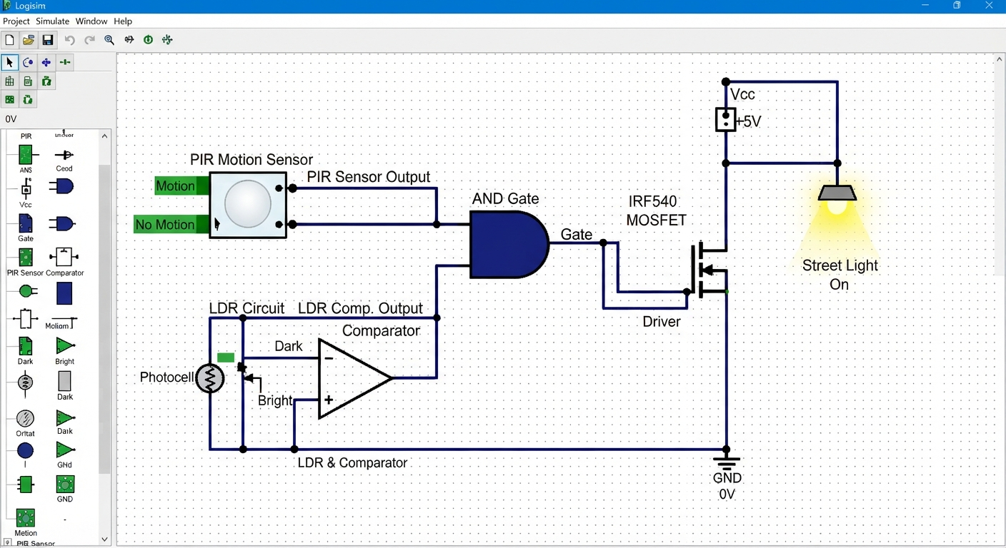
System Architecture / Block Diagram
06
Sensor signals flow through conditioning and logic before the power stage drives the LED lamp.
Automated Streetlight Control System
07
Notes:
Block diagram created for this project. The LDR/comparator converts an analogue light level to a digital logic input.

Slide 8
Methodology / Implementation
07
1
2
3
4
5
Sense light
Sense motion
Apply logic
Switch lamp
Test cases
LDR voltage changes with ambient light. The comparator outputs D = 1 in darkness.
PIR module outputs M = 1 when motion is detected in its field of view.
An AND gate computes L = D · M from the present input states.
The driver stage energizes a relay or MOSFET to supply the LED lamp.
Vary daylight, darkness, and motion conditions and compare outputs with the truth table.
Core hardware: LDR, resistor divider, comparator, PIR sensor, AND gate, driver transistor, flyback diode, relay/MOSFET, LED lamp, and regulated power supply.
For a prototype, test the low-voltage control circuit before connecting any mains-powered lamp.
Automated Streetlight Control System
08
Notes:
Implementation applies combinational logic from supplied Module 2 course materials. Safety note: use a properly rated isolated driver for a mains load.

Slide 9
Results and Discussion
08
Expected controller output for the four possible combinations of the digital sensor inputs.
Darkness D | Motion M | L = D · M | Lamp state
0 Daylight | 0 No motion | 0 | OFF
0 Daylight | 1 Motion | 0 | OFF
1 Dark | 0 No motion | 0 | OFF
1 Dark | 1 Motion | 1 | ON
Discussion
The output remains OFF in daylight, even when motion occurs. At night, motion enables the lamp command.
This verifies the Boolean expression L = D · M.
Demonstration record: simulate or build the four input cases and capture the LED/relay output in the final prototype report.
Automated Streetlight Control System
09
Notes:
Truth table is derived from L = D AND M. It provides expected results; physical prototype measurements should be added after testing.

Slide 10
Conclusion
The project demonstrates a practical application of combinational logic in an embedded streetlight controller.
Darkness detection
The LDR and comparator provide a reliable digital light condition input.
Motion-based control
The PIR sensor prevents lamp activation when the road is inactive.
Clear logic behaviour
The AND expression L = D · M maps each sensor state to a predictable output.
Safe expansion path
A suitable driver stage allows the design to interface with an LED streetlight.
Objectives fulfilled: sensing, logic control, output switching design, and truth-table verification.
Thank you
Notes:
Conclusion based on the proposed design and expected truth-table results.

